Slide 1
Employee Data Analysis using Excel
STUDENT NAME: U Karishma Kapur
REGISTER NO: 422200778
DEPARTMENT: B com ( ISM )
COLLEGE: Annai Velankannis College for Arts and Science

Slide 2
PROJECT TITLE
Employee Performance Analysis using Excel

Slide 3


AGENDA
Problem Statement
Project Overview
End Users
Our Solution and Proposition
Dataset Description
Modelling Approach
Results and Discussion
Conclusion
3/21/2024 Annual Review

Slide 4

PROBLEM STATEMENT
It Accurately evaluate employee performance
Identify Strengths, Weakness, Opportunities and Threats ( SWOT analysis )
It develops targeted interventions and training programs
It corrects Insufficient training programs
It declined employee engagement.
Inequitable compensations.

Slide 5

PROJECT OVERVIEW
It Analyse employee data to identify trends, patterns, correlations and inform dat – driven decisions for HR and Management.
Here are some benefits of out project overview,
Data – Driven decision making
Enhanced employee engagement and retention.
Improved productivity and performance
Better resources allocation and planning.

Slide 6

WHO ARE THE END USERS?
HR department
Management Team
Employee
Compensation and development
Diversity
Business leaders
IT and Analytics
External Partners.

Slide 7

OUR SOLUTION AND ITS VALUE PROPOSITION
Turnover predictions
Skills Gap analytics
Diversity and inclusions
Employee engagement
Succession Planning
Employee experiance

Slide 8
Dataset Description
Dataset Description: This data set contains information on employee performance , demographics and development activities.
Fields:
Employee ID
Name
Job Role
Department
Performance rating
Performance level

Slide 9
MODELLING
Regression analysis
Decision trees
Clustering analysis
Predictive modelling
Propensity scoring
Survival analysis
Network analysis
Simulation modelling
9

Slide 10
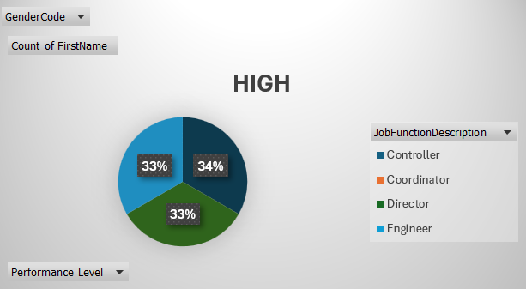
RESULTS
10

Slide 11
conclusion
Data analysis has provided actionable insights into employee performance, revealing areas of strength and opportunities for improvement.
This conclusion summarizes the key findings and recommandations from the data analysis, and provides a clear directions for future actions. It highlights the value of data analysis in f=driving business outcomes and improving employee performance.

